Slide 1

Transfer Learning: The Hugging Face Platform

Slide 2

Notes:
Setup Instructions…

Slide 3


Slide 4

A Tour through the Hugging Face Hub
https://huggingface.co/models
https://huggingface.co/datasets

Slide 5
Let’s say you want to build a news summarizer…
“Tesla’s stock plummets as CEO tweets nonsense.”
DOCUMENT
SUMMARY
Image Credit: https://medium.com/@jaskiratnandhra/extractive-text-summarization-for-english-hindi-tamil-4cf37e81091c

Slide 6
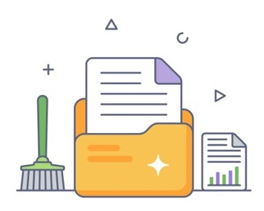
First, you need to collect and clean a dataset
Image Credit: https://www.vecteezy.com/vector-art/6094871-data-cleaning-in-flat-outline-icon-editable-vector

Slide 7
Then, you need to pick and train a model…
…which can take a while
Train
Tweak
Hyperparameters
Evaluate

Slide 8
Is there an easier way?
Leverage work of the ML ecosystem
Don’t reinvent the wheel
Collaborate-first culture
Open Source
Notes:
Well, this can be much simpler actually.
Now if you’ve used GitHub before, you probably did an initial search of the repositories to find code that could be re-purposed for your needs. Also, you will probably collaborate with your team by way of a shared repository. And once you’re ready, you can open source for the whole ecosystem to use. We can do the same with ML!
Why have hundreds of people training models that do the same things again and again? Why not share a central platform through which people could collaborate, explore, and discover models and datasets.
That’s the value of Hugging Face. The HF Hub is a platform of more than 30K models and 3K datasets in which people can easily collaborate on their ML projects.

Slide 9
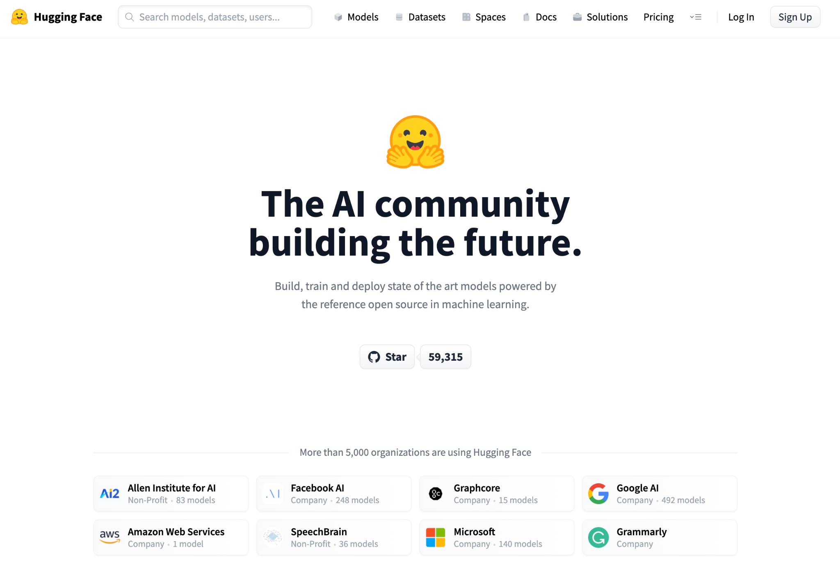

Notes:
So how does Hugging Face do that?
HF aims to make Machine Learning accessible in the following ways:
Easy to access – easy to try things out.
Engineered via open source libraries.
Commitment to open science – sharing of models, datasets, and applications.

Slide 10
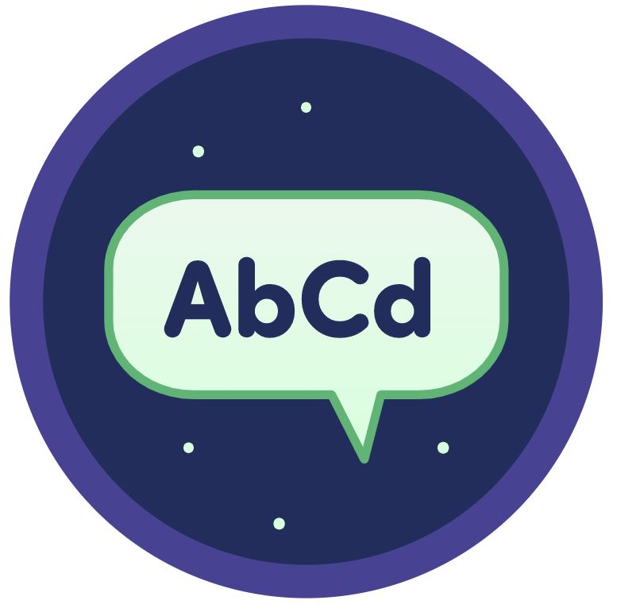






Solving Problems
NLP
Speech
Vision
Bio/Chem
Time Series
RL
Domain X
Notes:
And although our origins come from the NLP domain, the HUb has expanded to applications across other domains:...
HF seeks to democratize good Machine Learning, making it accessible to everyone, allowing anyone to contribute to the greater good.

Slide 11
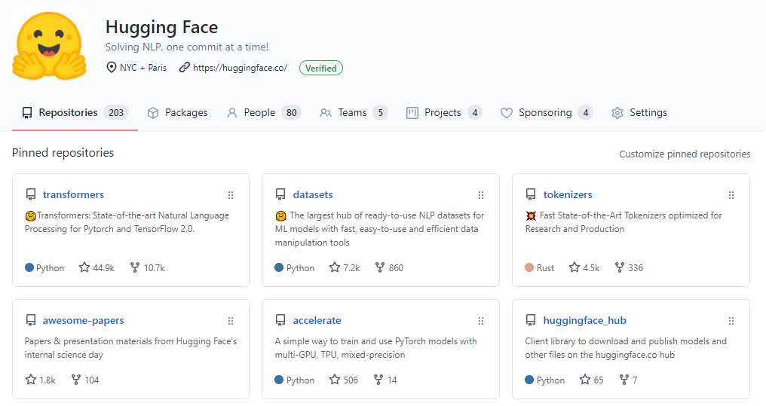
Brief tour through Open Source family
Notes:
Today we’ll preview the Hugging Face Open Source Ecosystem.
GitHub enables open source sharing.
Some of the HF repositories are pictured here.
GitHub is important to HF as this is a community-centered effort.
HF has more than 1000 Open Source contributors without whom the libraries wouldn’t exist.
58K stars in GitHub

Slide 12
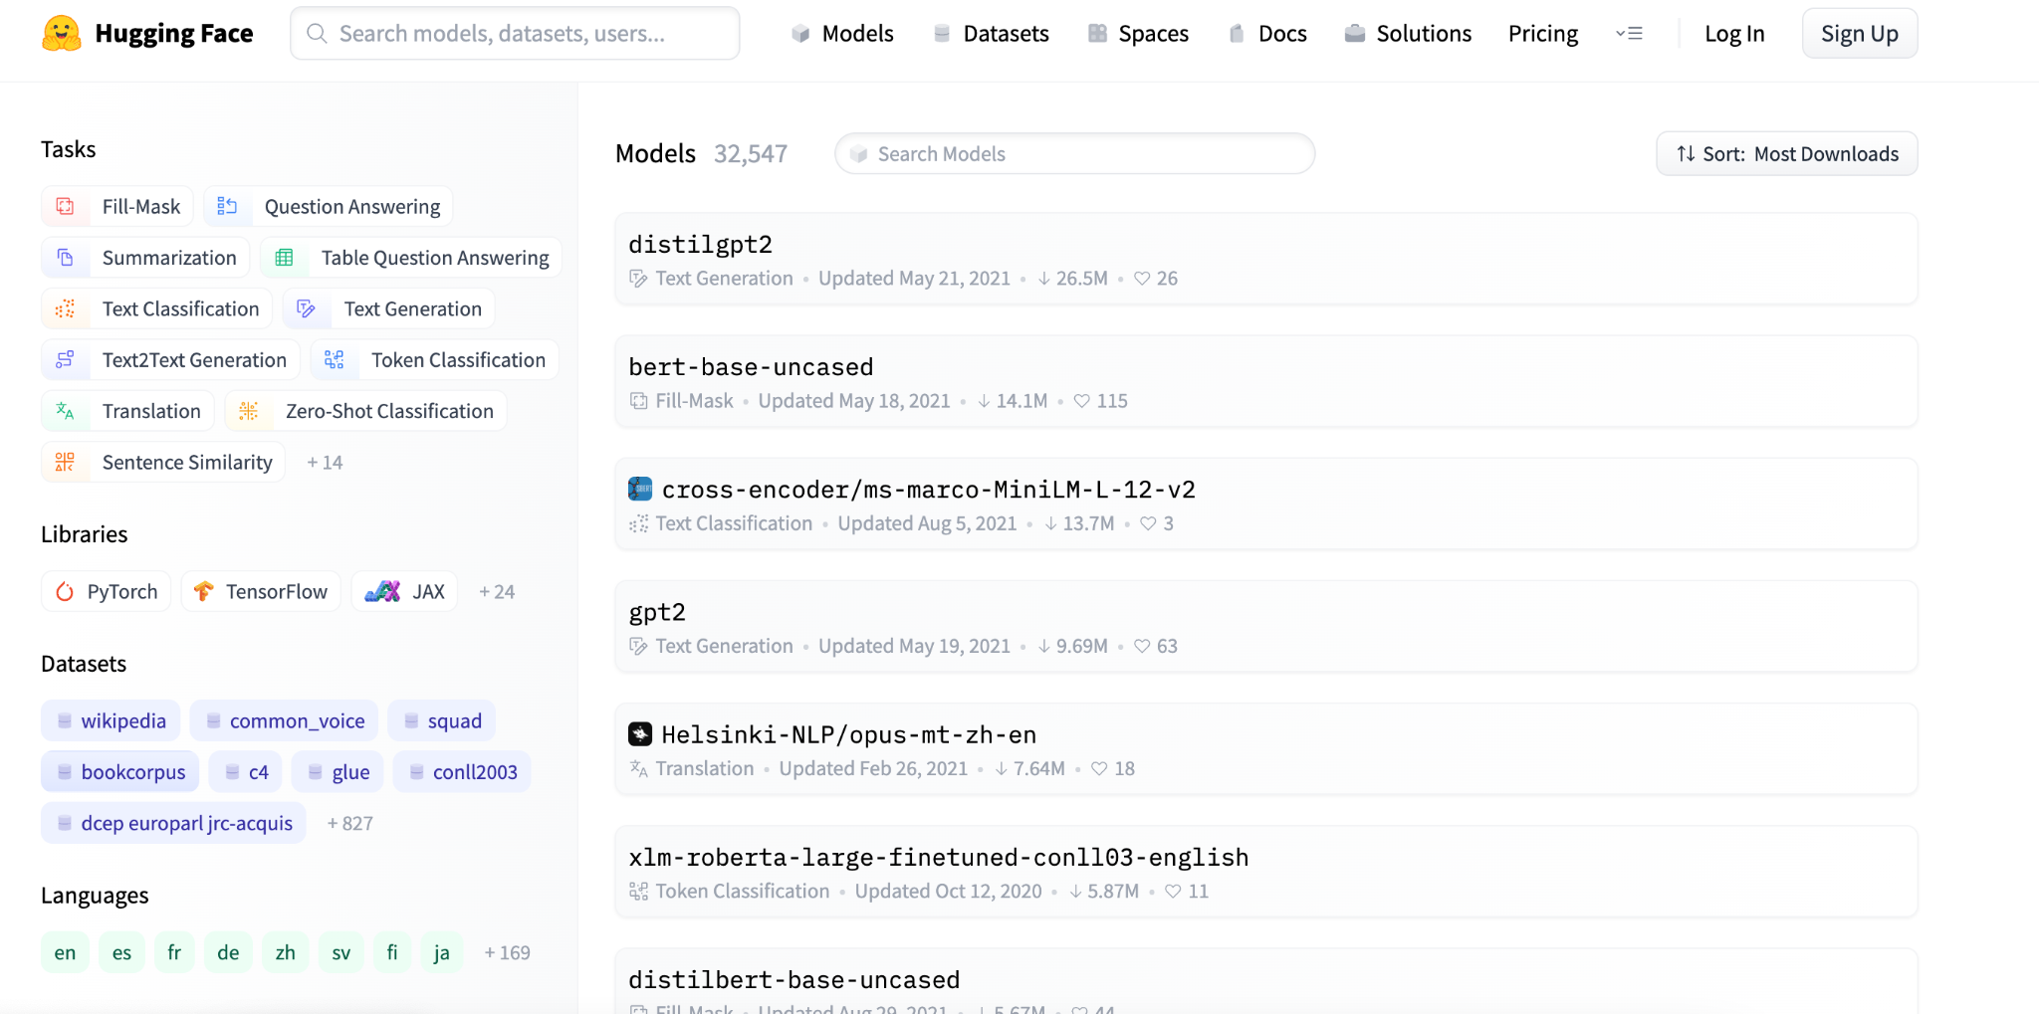
How can I find models?
Notes:
Okay, let’s begin with the model hub. First off, the models in the Hub are built using a wide variety of tools and frameworks – transformers and other NLP frameworks (AllenNLP or Flair), vision frameworks like pytorch-image-models, or timm, and other fields like speech, with pyannote, ESPNet, and others.
The hub serves as a central sharing point for all models. As such:
- It enables reproducibility. By sharing checkpoints, users offer them to be tested by other users, and evaluated.
- It saves on training, as shared pretrained models (trained on massive datasets) can be fine-tuned.

Slide 13
The Model Hub
>30,000 public models
>20 tasks
>15 libraries
>180 languages
Notes:
Quick summary of the model hub.

Slide 14
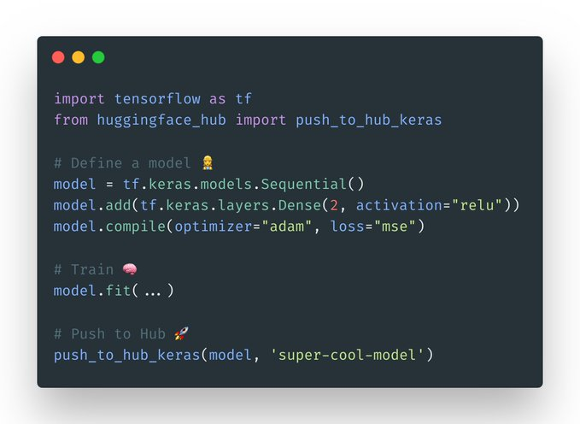
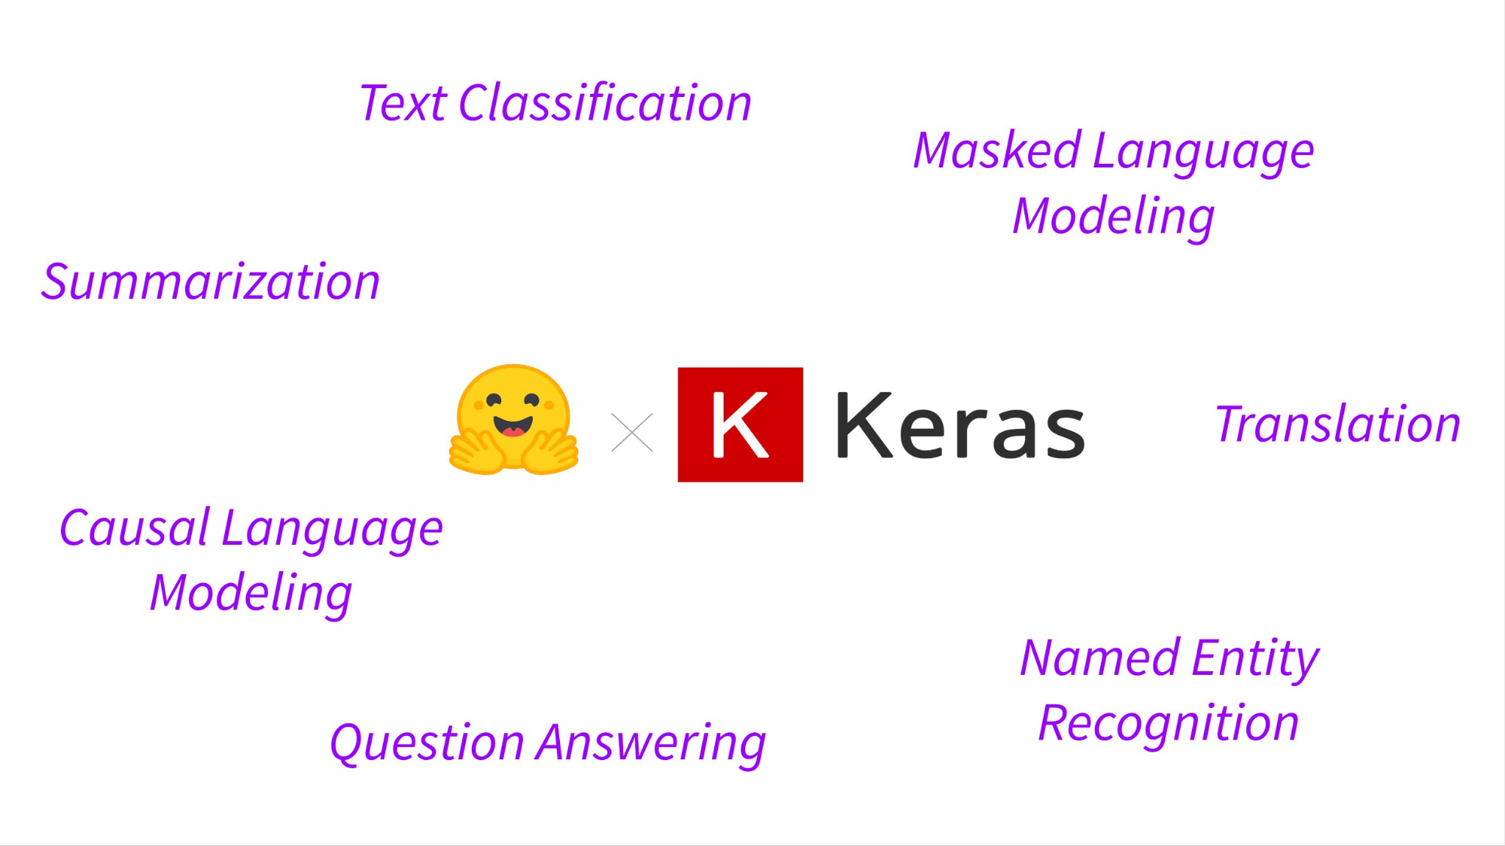
Use with any library you love!

Slide 15
Standard Workflow
Model Hub
Model
Model Hub
Pick a pretrained model
Upload it once trained
Train using a dataset
Datasets

Slide 16
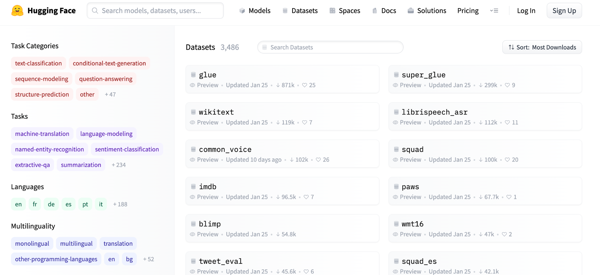
Datasets Hub
Notes:
The Hub also contains datasets. The datasets hub is a catalogue of datasets shared by the community. Load datasets in one line of Python. It contains well known datasets such as SQuAD or the GLUE benchmark, as well as many others for classification, question answering, summarization, language modeling etc.
The datasets hub has more than 3000 datasets. As is the case witht the model hub, each dataset is versioned with git to support reproducibility.

Slide 17
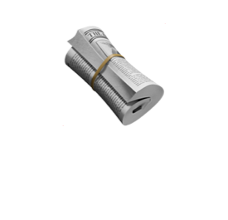
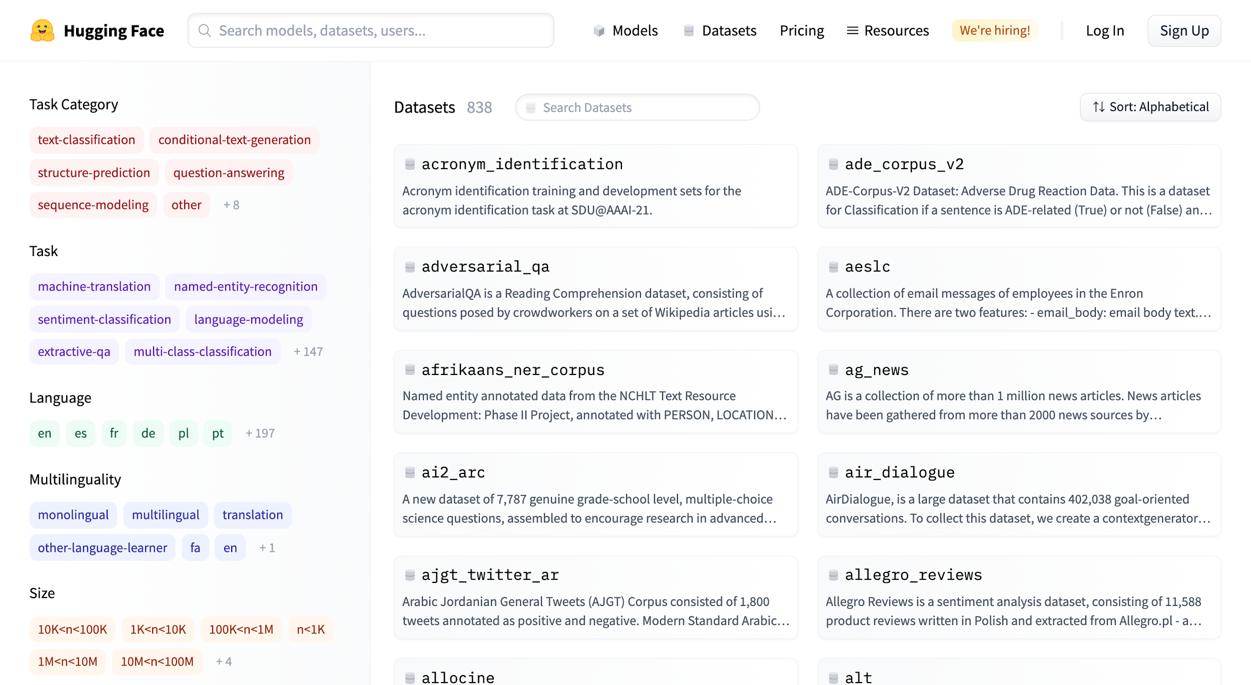
Datasets
The Hub:
- Largest hub of ready-to-use datasets
- 3000+ Datasets available
- 450+ languages and dialects supported

Slide 18
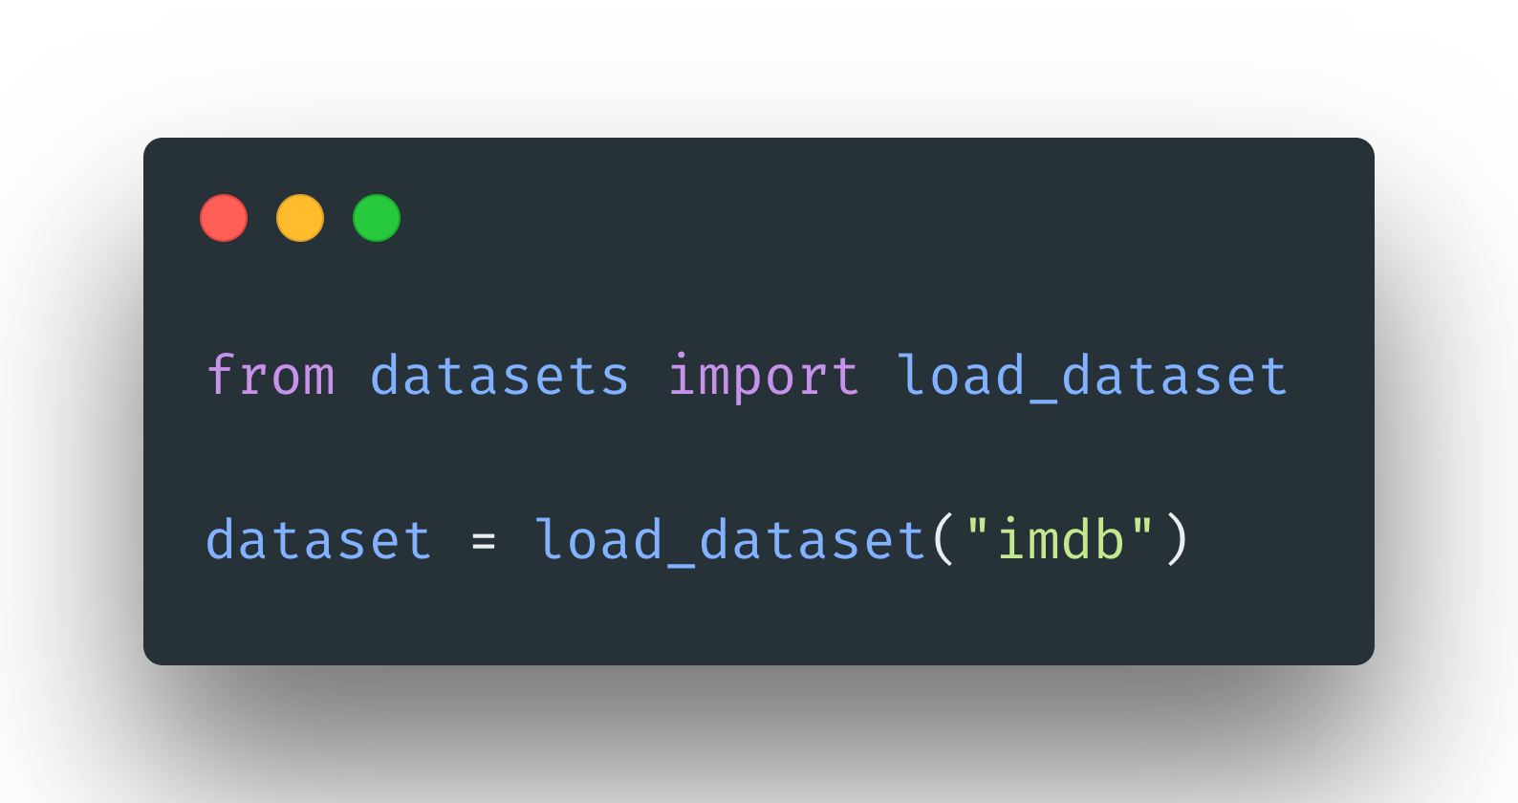
Datasets
The python library:
- Load any dataset in one line
- Supports huge datasets without RAM limitations
- Fast iterations and querying

